Slide 1
Volcanoes
By Abbie Roecker

Slide 2
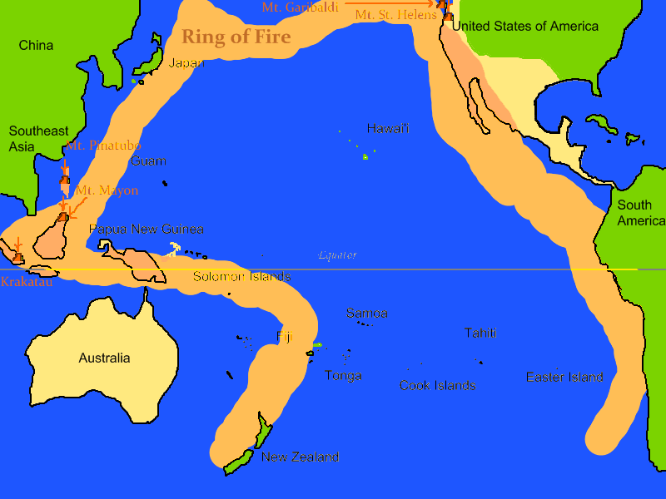
The ring of fire!
Paragraph names
Introduction
What is a volcano?
What causes an eruption?
All about Santa Maria
How to help
Closing
The End

Slide 3
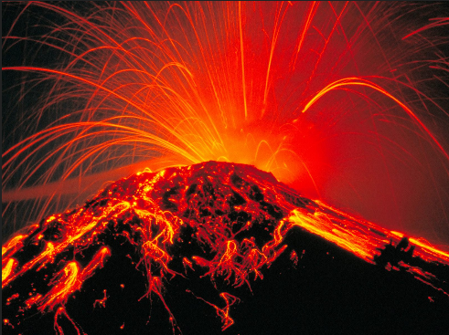
Introduction
Ever wonder how a volcano erupts and what happens after that? Well I do! So now for the volcanoes!

Slide 4
A volcano is made by pressure that builds deep inside the earth. Magma is pushed to the surface, magma that reaches the surface is called lava. Volcanoes can cause earthquakes or land slides, and can destroy crops or buildings.
What is a volcano?

Slide 5
What causes an eruption?
A volcano erupts because things like tree roots and pipes cause pressure.
#explosion

Slide 6
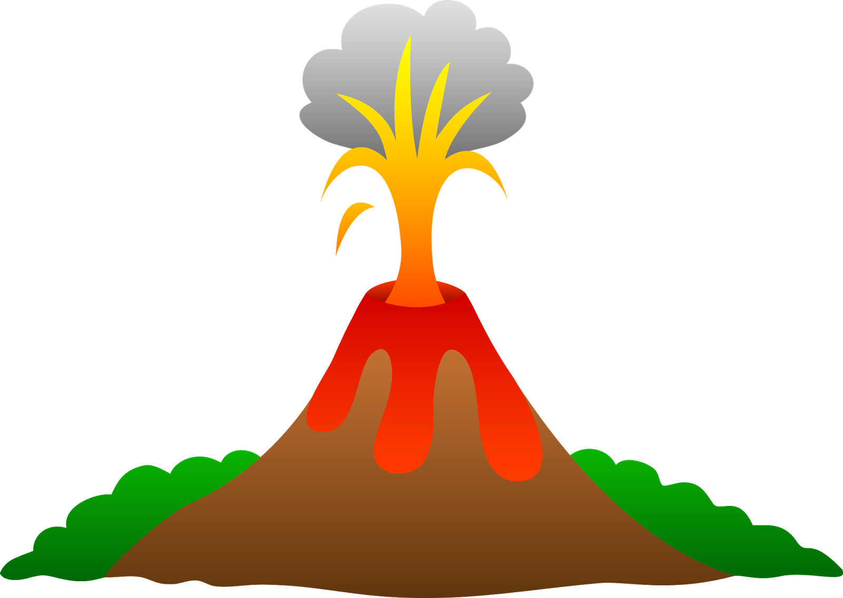
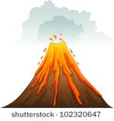
The Santa Maria is a 30,000 year old volcano built on a basement of older rocks. While the main cone of Santa Maria is no longer active, the domes of santiaguito have created a number of volcanic hazards since their growth began.
All about Santa Maria

Slide 7
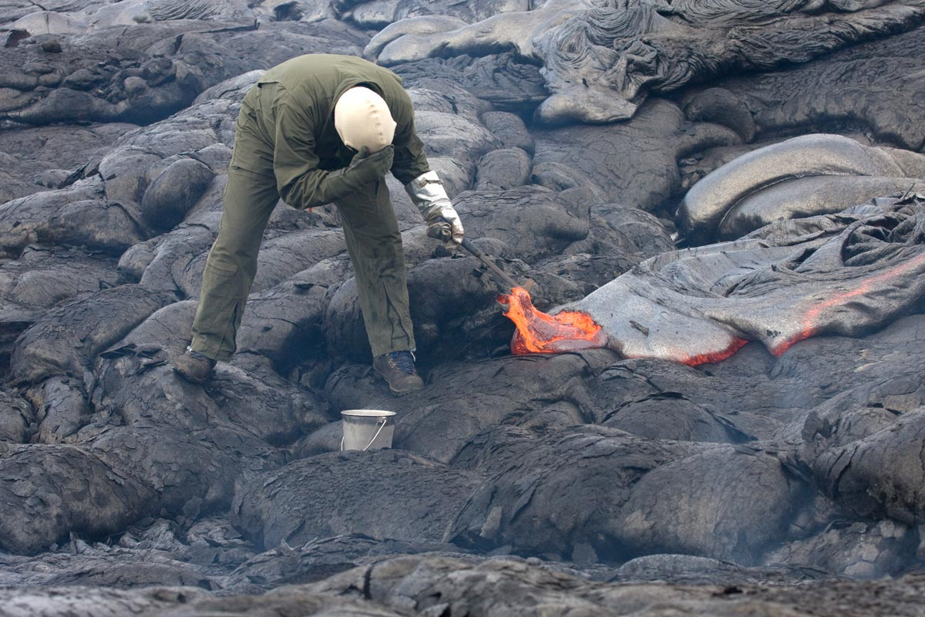
How to help
What can we do about this? Well some scientists and/or engineers watch volcanoes and measure their activity, scientists try to predict when a volcano will erupt. They can tell people to leave the area and stay safe.

Slide 8
Closing
Well hope you enjoyed! Just ask or see other power points.

Slide 9
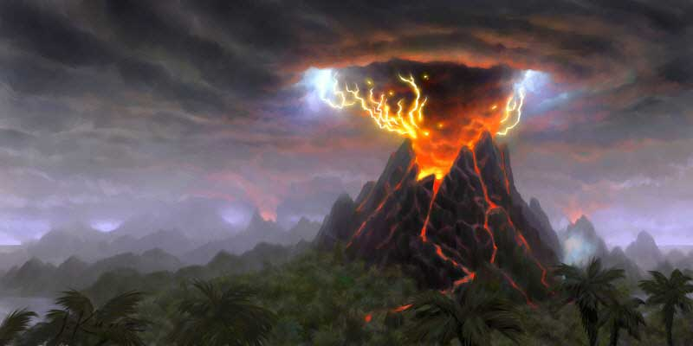
The End!
Hope you liked it!

