Slide 1
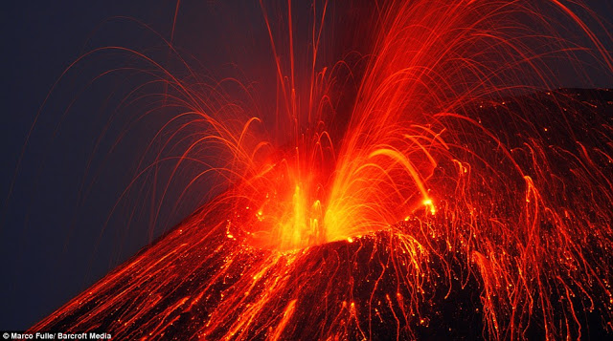
The Krakatau eruption.
By Alex N.

Slide 2
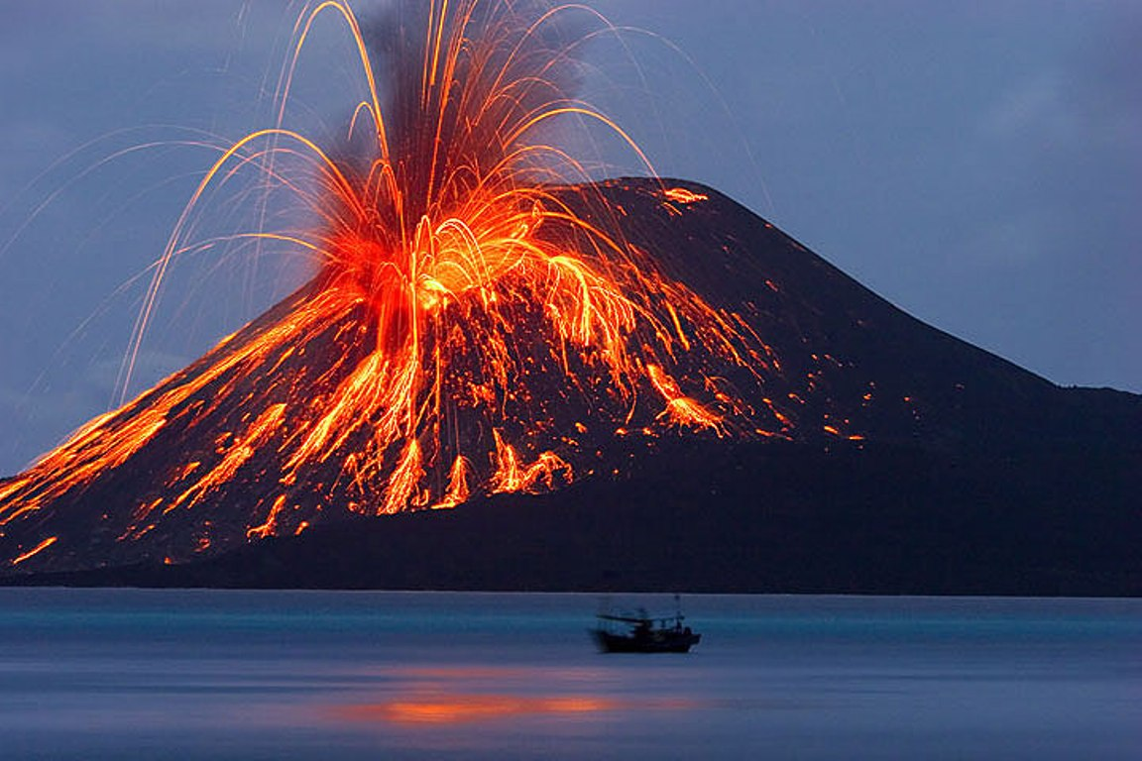
In 1883 THERE WAS a explosion so big it was more massive than a atomic bomb. The only thing that was this powerful is the Krakatau eruption!!!!!!!!!!!!!
These sparks can shoot up to 30,000 feet (10,000 yards)
The Krakatau eruption killed 34,000s of people and caused tsunamis to China, India, New Zealand, Australia, Japan, and the rest of Indonesia. The eruption was the most deadliest eruption and killed the most people ever recorded.
Ahhh! Lava!
Dangerous!

Slide 3
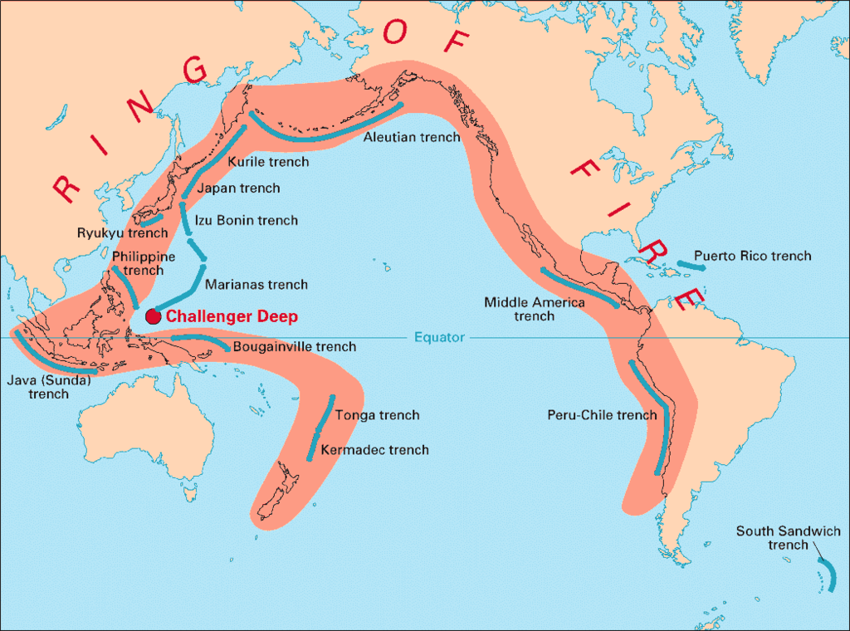
The location of the eruption.
The volcano sat on a fault line and is part of the ring of fire. Before the eruption the volcano was spewing out ash two days before the eruption the sea started to shake and then it exploded
HEARD OF THE RING OF FIRE?

Slide 4
the explosion took out all of the neibioring villages with the blast. The eruption shook the whole world. The eruption was followed by a black smoke screen so the villagers couldn't see. The explosion was heard 10,000 miles away.
The metal is catching on fire.
Lava pouring into a yard
Beginning of the ash spew
!!!!!!!!!!!!!!!!!!!!!!!!!!!!!!!!!!
?????????????????
HOPE THAT IS NOT MY YARD!

Slide 5
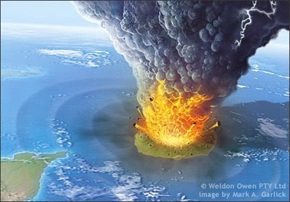
WHEN THIS PART OF THE VOLCANO ERUPTED IT BLEW UP THE WHOLE ISLAND ALL THAT WAS LEFT IS A LITTLE PART OF THE VOLCANO THAT IS STILL ACTIVE.
Scientist are trying to tell people to build there shelter far away from a volcanos they are also trying to deactivate volcanos.
Some of these rocks can shoot to the coast of India.

Slide 6
I hope you enjoid my presentation about the Krakatau eruption. watch out there might be a volcano sprouting in your back yard!
Boom shaaklaaakalaaka!!!!
😎😒😜😎😎😎😎😎🍤🍕🍔🍗🍦🍧🍨🍪🍩🍫🍬🍭🍮🍰🍜🍖🍟🍞🍝🍛
THKS FOR WATC-ING
Video that will have a 40% of working.

