Slide 1
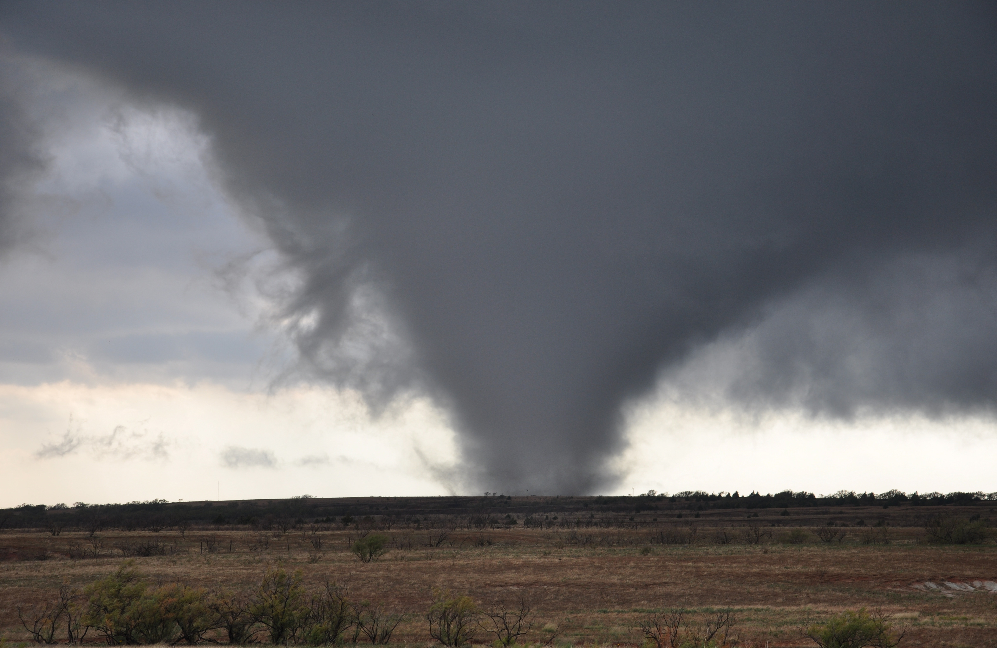
The death tornado!!!!
By: Chloe miller

Slide 2
Introduction
A tornado is sometimes called a twister. It is a rapidly spinning tube that touches the ground and a cloud above.

Slide 3
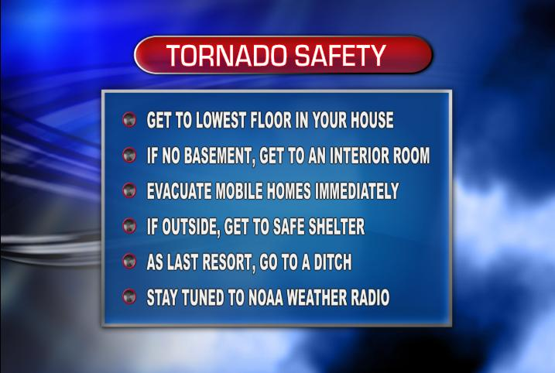

Slide 4
Why do tornados happen?
Help!!!!!!!!!!!!!
When warm air and cold air mixes together it creates a tornado! When this mob is formed it destroys cars and other vehicles and people.

Slide 5
What is the impact on people?
TORNADOS ARE DEADLY, YES BUT WE NEED TORNADOS! Everybody at least should experience a tornado once in their life!!!!! Have you ever been at a REALLY tall place and looked out the window and seen a BIG thunder storm? It’s probably a tornado forming.

Slide 6
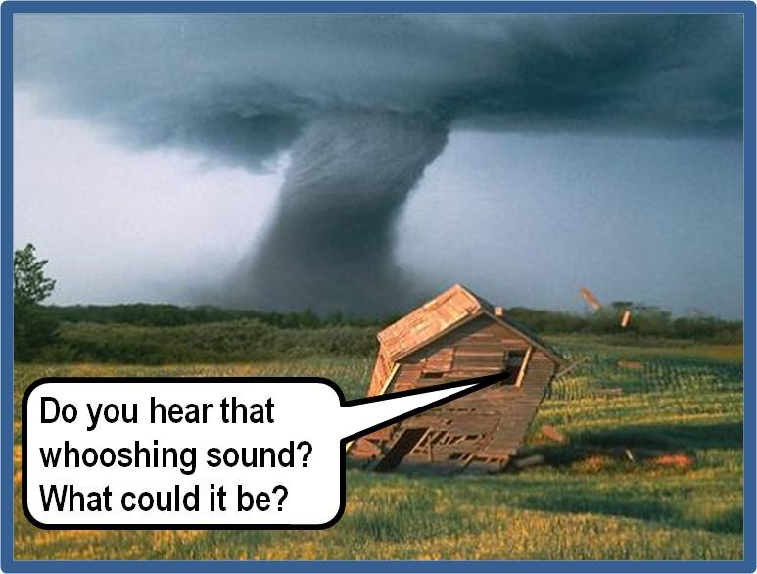
Oh, it must be a tornado. Oh wait, ahhhhhh!!

Slide 7
Depscribe the tornado!!!
Depscribe it!!!!!!!!!!!!!!
The tornado is very deadly!!!!but it have helped in a way. But. I don’t know what that help was. But it was on april 26th 1989 in Bangladesh, india

Slide 8
closing
And so that brings us to the end!!!!!!!!!!!!! Now go tell ALL your friends your knowledge!!!!!!!!

Slide 9
Resources!!! (that I used)
Well well well…… hear we are! The info that you are seeking is: google, books. That’s it.

Slide 10
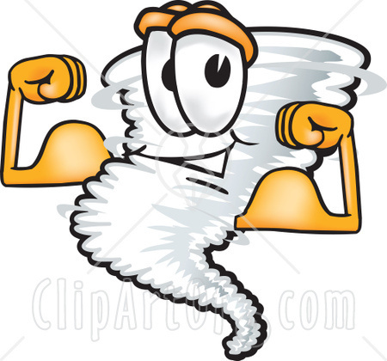
Thank you!!!
I AM STRONG!!! MWHA HA HA HA!!!
Homie!

