Slide 1
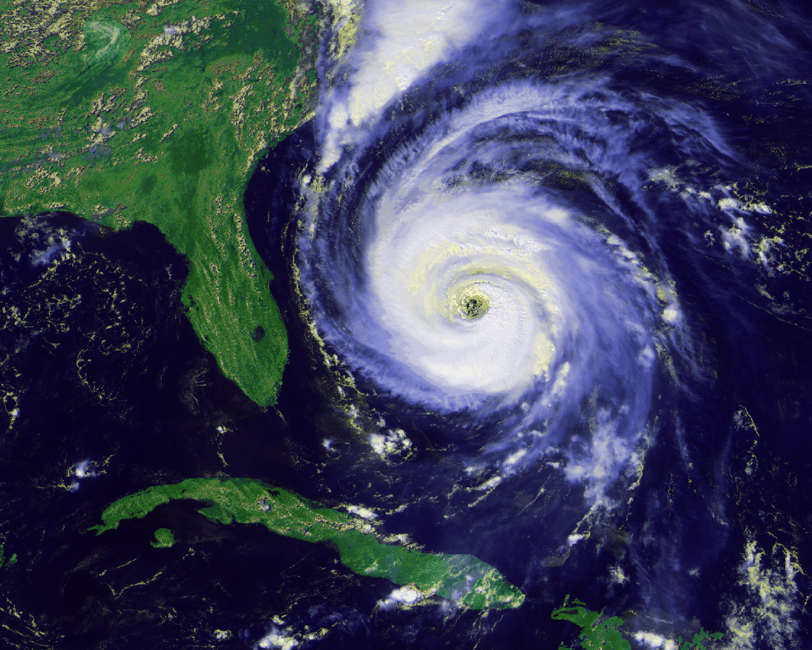
Hurricanes…
BY: Claire😉👍🎧

Slide 2
What is it?/Impact😖
So what is a hurricane? Hurricanes are super storms that are huge and land. The impacts: When a hurricane happens buildings get destroyed and people get trapped under rubble, and sometimes the flood water gets infected with chemicals and nobody can eat or drink the stuff that’ s been in the water. They knock trees and buildings get swept away. People stay on roofs to avoid the water. After a hurricane happens rescue helicopters come to pick up the people who survived. A few people die of hunger, sickness from the chemicals, or drowned. That’s impacts and what they are!
Center
Eye

Slide 3
Why does a hurricane happen?😕
First wet air will rise over a warm ocean , and somewhere else it’s raining and rain joins the wet air. Than wind joins the circle of wet air and rain and they form the eye and goes to shore often in summer and fall. That’s how hurricanes happen!

Slide 4
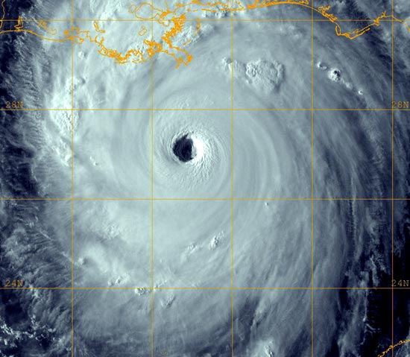
Hurricane Katrina😭 X_X
On August 29th Hurricane Katrina made impact when it hit the golf coast of the U.S. T here was massive flooding and wind and rain, and a lot of people got trapped in and under buildings and rubble and everything got destroyed or knocked down. They water was full of deadly chemicals and people couldn’t drink or eat. 18,000 people died of 1. of hunger 2. drowned 3. drank chemicals and became sick and 4. trapped under rubble. The people who did survive got rescued by helicopters. 90,000 acers of the U.S got effected from Louisiana to the Mississippi, and some of the ground got swept away!

Slide 5
WHAT ARE ENGINEERS DOING ABOUT IT?
Sadly, all engineers have are hurricane trackers , and the most hurricane-proof house has little to no windows, thick and water-proof walls and is a bunker, but who would want to live there?! Here are some ideas: 1. build a wall. 2. houses are nailed or cemented into stone 3. double walled and roofed 4. all 3 of those put together. There are some ideas, and now write your own on a sticky note!😆😛!

Slide 6
THE END!!!😊😉😛👍🍔🎧
We will share ideas now!!!
HOPE YOU LIKED!!!!!😍😏😉

