Slide 1
EarthQuakes
By Alex P.

Slide 2
Introduction
I decided to learn about earthquakes because earthquake can cause huge tsunamis and because earthquakes are a very dangerous natural disaster. Earthquakes can collapse buildings, destroy roads and much more. Earthquakes are also very deadly.

Slide 3
Impact on people
Earthquake can kill people and leave people with no homes. Earthquakes can do so much in minutes. The ground rumbles with power.
IMPACT ON PEOPLE

Slide 4
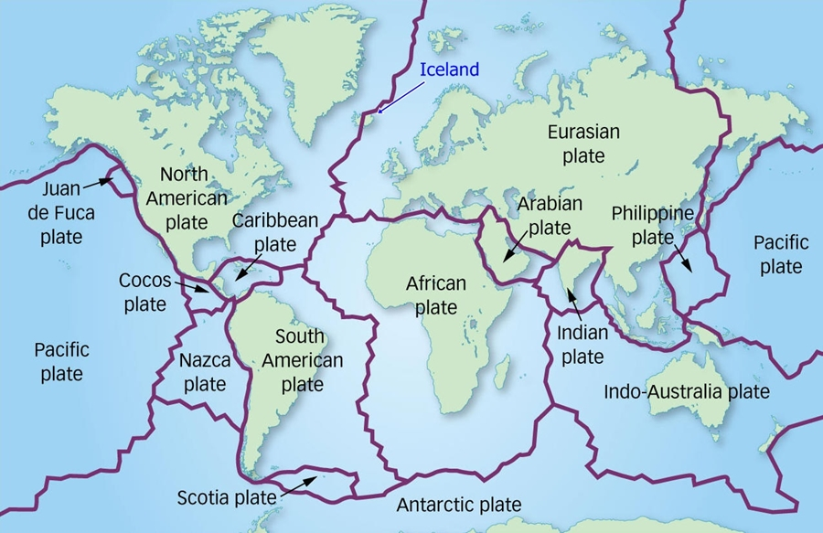
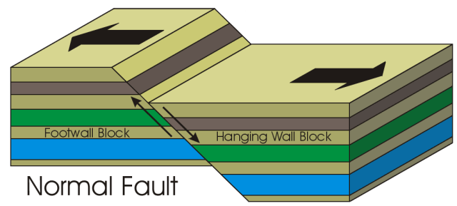
Why do Earthquakes happen?
Earthquakes occur when tectonic plates tug free, sending seismic waves that reaches Earths surface causing an earthquake. Earthquakes are measured using a Ricterscale. Tectonic plates meet at fualts.

Slide 5
The San Francisco Earthquake
The San Francisco Earthquake was measured at 7.8 Magnitude.
It only lasted for a minute and the damage estimated $8.2 Billion dollars!
The San Francisco EarthQuake

Slide 6
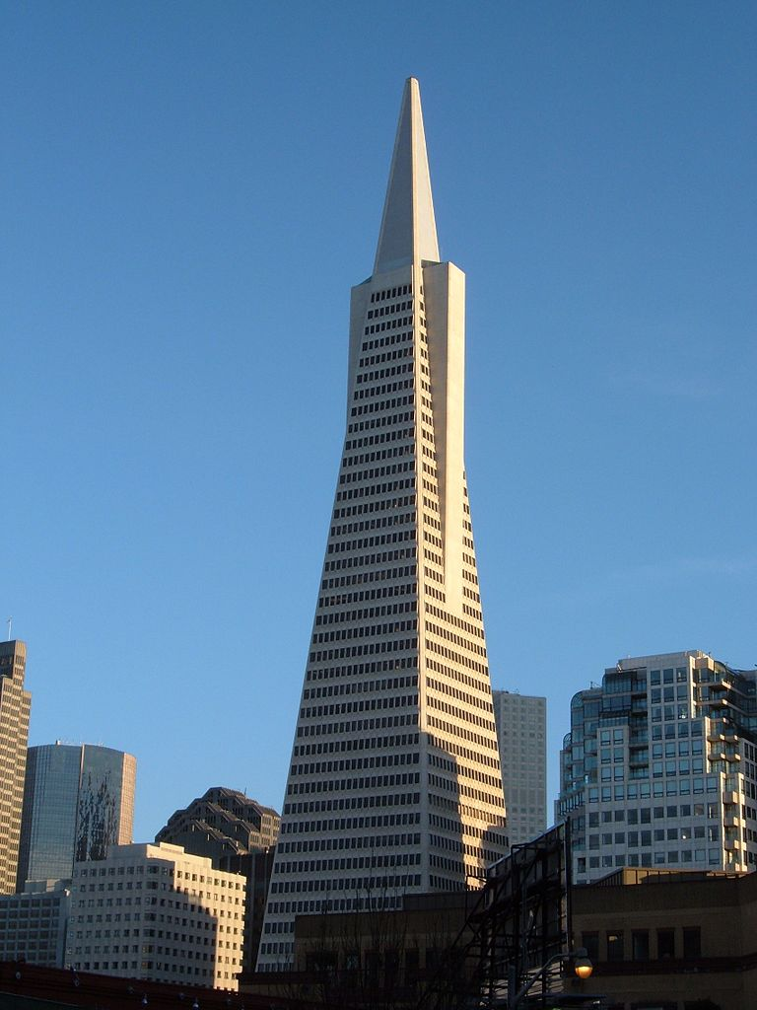
What are Engineers doing to help?
Engineers are building earthquake proof buildings like the Transamerica pyramid. They are also making houses stronger and more protective.
Transamerica Pyramid

Slide 7
Experience an Earthquake.
TREE
TREE
Hello
ROCK
ROCK
ROCK
ROCK
GROUND

Slide 8
T H A N K S F O R W A T C H I N G
T F W
H O A
A R T
N C
K H
S I
N
G
Check out these websites for more information.
Check out these websites for more
Information

