Slide 1
floods
By:
Jack

Slide 2
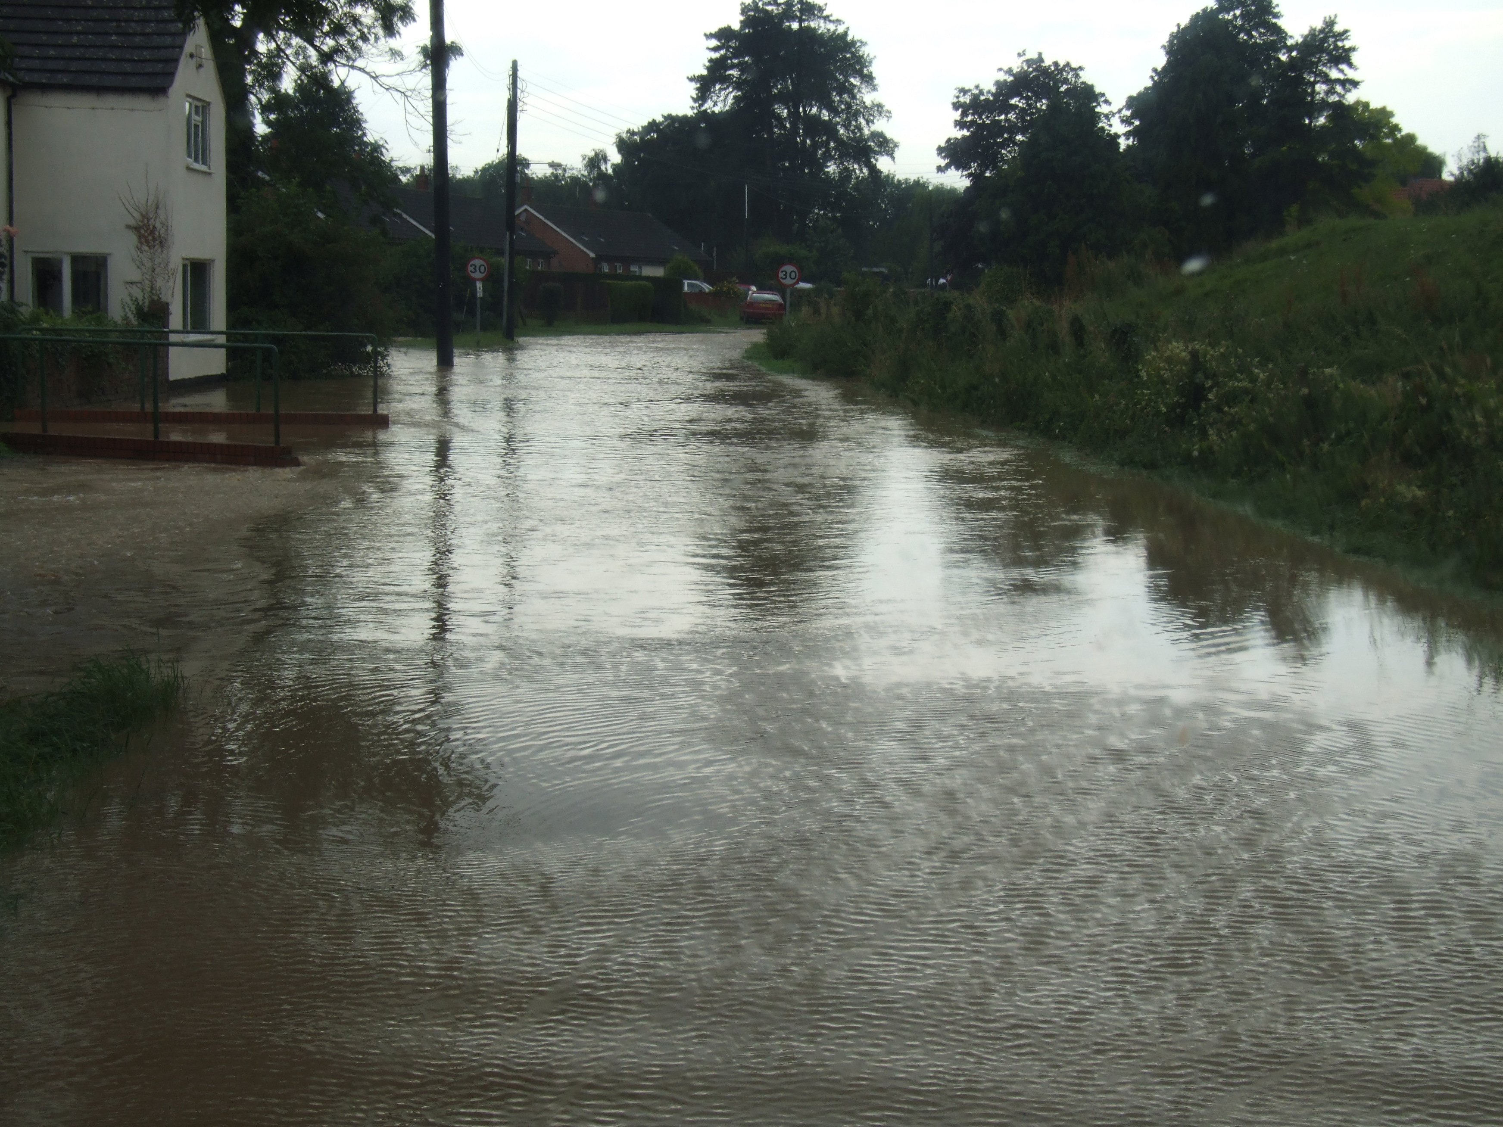
Floods
Floods are rivers, lakes, oceans and other masses of water that have over flowed. Even a river near you
like the Raccoon or Des Moines rivers. Some can cause millions of dollars in
Damages .

Slide 3
Why dos it happen?
It is usually because of
Heavy rainfall
Melting snow
But every once in a while a dam breaks
And all the water
FLOODS!

Slide 4
The flood of 1993
The flood was so bad people had to
Get bottled water to drink.
Boats were used for transportation.
And you couldn't drive your car.

Slide 5
ENGIINEERS
They build dams to keep back water so it doesn't flood.
Only lets small amounts out

Slide 6
Sourses
True flix
The news
Mrs. Tyler
Andi/my mom
A article called the flood of 1993

Slide 7
cause
Heavy rainfall
Melting snow
What
happens
No water
Ask mrs.tyler
effect
Pepel loss homes
No water

Slide 8
Turn around don’t drown
Hope you enjoin the show
The end!😎

