Slide 1
The japan tsunami
By Kaylee

Slide 2
What is a tsunami / Introduction
Today I’ll be talking about tsunami. I picked this natural disaster because it seems like a fun thing to research . What is a tsunami? Well it is a set of ocean waves . A tsunami is the Japanese word for harbor wave . And when the water moves then the ocean starts to shift.

Slide 3
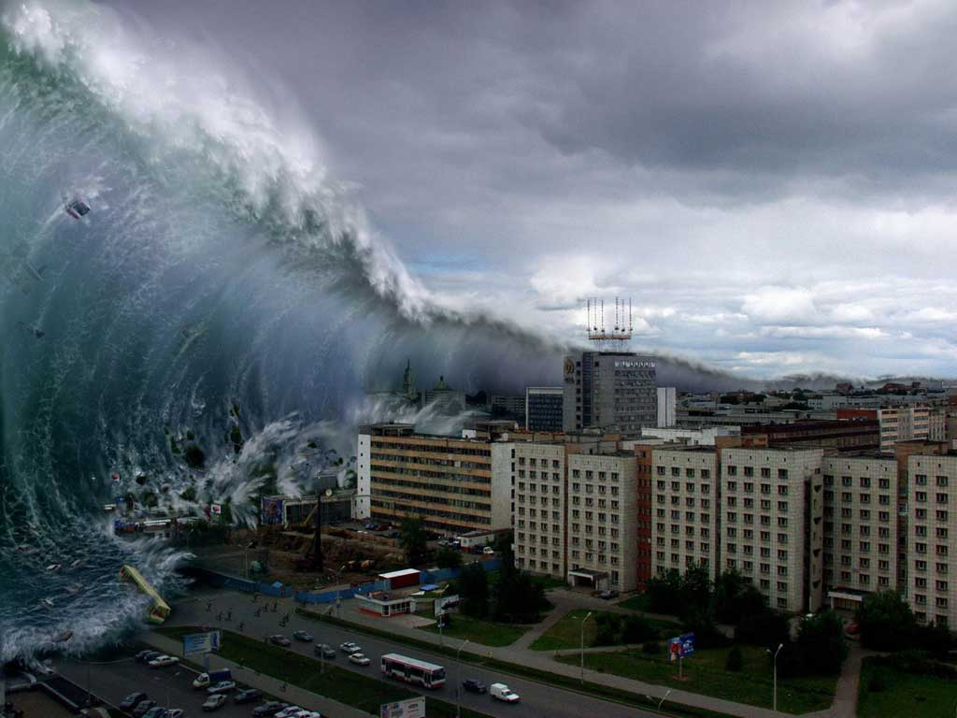
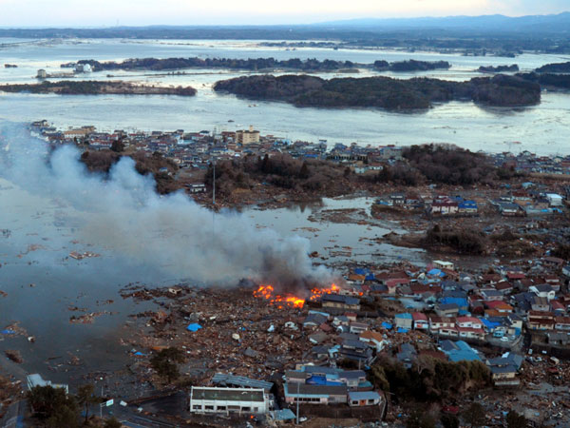
What impact did it have on people and the area
The impact it had on people was that it could effect homes jobs food and almost everything. It effects trees buildings and stores and a lot more.

Slide 4
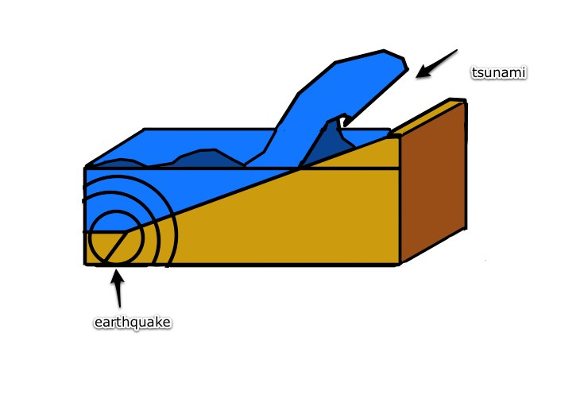
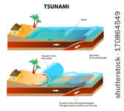
Why does it happen
It happens because of earthquakes landslides and volcanos can cause a tsunami plus when dirt and lava hit the ocean water and it also it will make waves

Slide 5
More about the japan tsunami
In 2004 the deadliest tsunami in history happened well after the big tsunami more than 150,000 people died that day WOW.

Slide 6
What impact did it have on the area it nocked down trees buildings having to build it all again

Slide 7
What are engineers doing about it
They are building big sea walls and putting this salt down and they put sirens on.

Slide 8
Picture's

Slide 9
thanks for listening

Slide 10
My website was true flix

Slide 11
