Slide 1
Landslides
BY
BEN

Slide 2
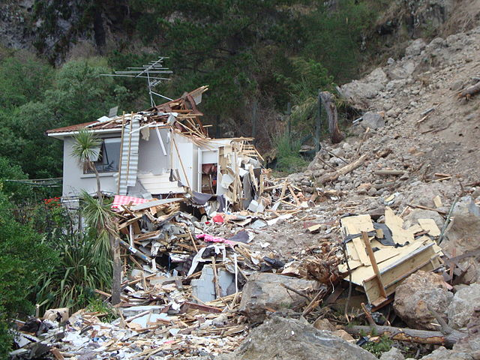
Introduction
Today I'm going to tell you about landslides its one of a big natural disasters

Slide 3
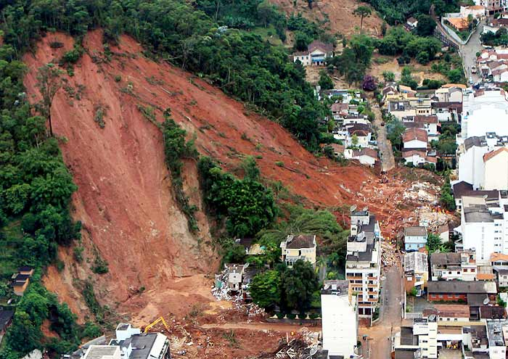
What is it/impact
What is a landslide? A little side of a slope curved and trees are on it when it rains the trees are on it when it rains the trees fall with mud and. The impact is this can kill over one million people.

Slide 4
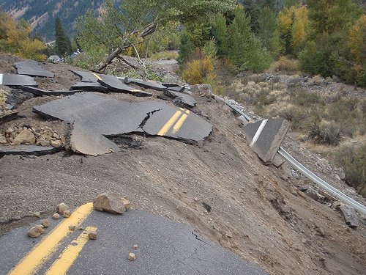
why does it happen
There's a slope that rain goes in it. It falls down whit mud and rocks and trees then it falls down on the houses.

Slide 5
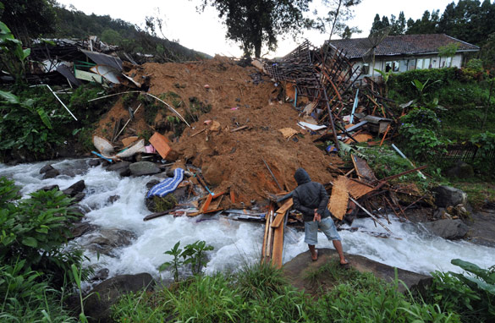
Describe the specific natural disaster
It happen in the Mississippi river it broke the bridge it killed more than one hundred people and 2000 homeless died.

Slide 6
What are engineers doing to help
They are building walls and big dams to help so the landslides not break though

Slide 7
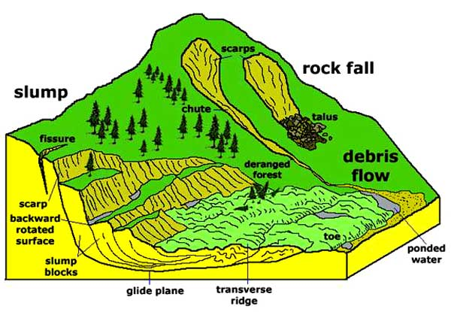
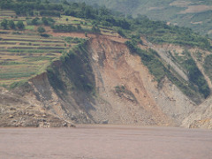
Pictures

Slide 8
Sources
Ture flix
pebble go
Wikipedia
Mrs. Tyler's help

Slide 9
END
Thanks for watching hope you like have a good day.

