Slide 1
Volcano/pompeii !!!!!!!!!!!!!!!!!!!!!!!!!!!!!!!!!!!!!!!!!!!
By trey and Isaiah

Slide 2
The natural disaster
ggg

Slide 3
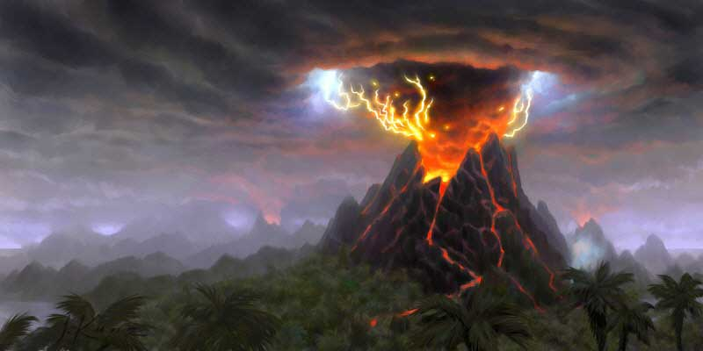
The natural disaster I researched is volcanoes. Some things I learned are as a volcano erupts it gets bigger and bigger because the lava dries and turns into rock.

Slide 4
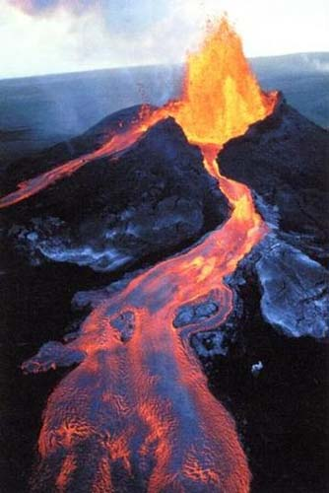
How it happens
Two plates rub together and get hot and turn into magma. The magma rises to the surface and then lava comes out.

Slide 5
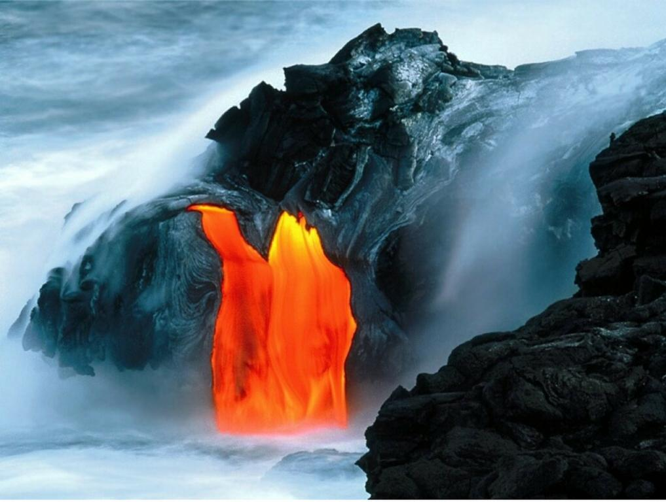
Volcanoes can be bad by destroying peoples houses and can kill people. volcanoes can be good because they can make land and fertilize soil.
What the impact on people is.

Slide 6
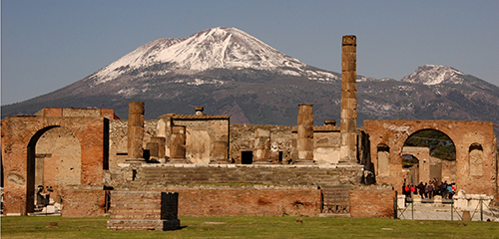
I learned about pompeii. the town was covered in ash. Hundreds of years they unburied the town
Pompeii .

Slide 7
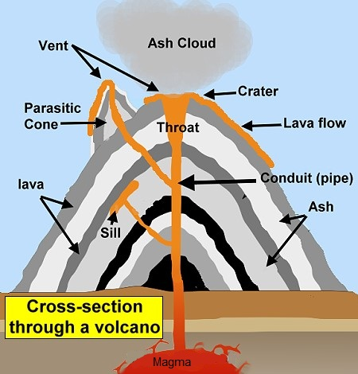
SCIENTISTS ARE WATCHING VOLCANOES VERY CARFULLY. THEY WATCH: HOW MUTCH GAS COMES OUT, HOW HOT THE ROCKS ARE NEAR THE VOLCANO, AND HOW MUTCH THE EARTH SHAKES.

Slide 8
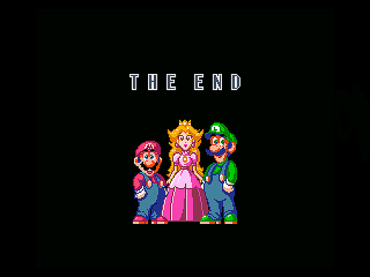
THE END!!!!!

