Slide 1
Thunder and Lightning
By Nevaeh stewart

Slide 2
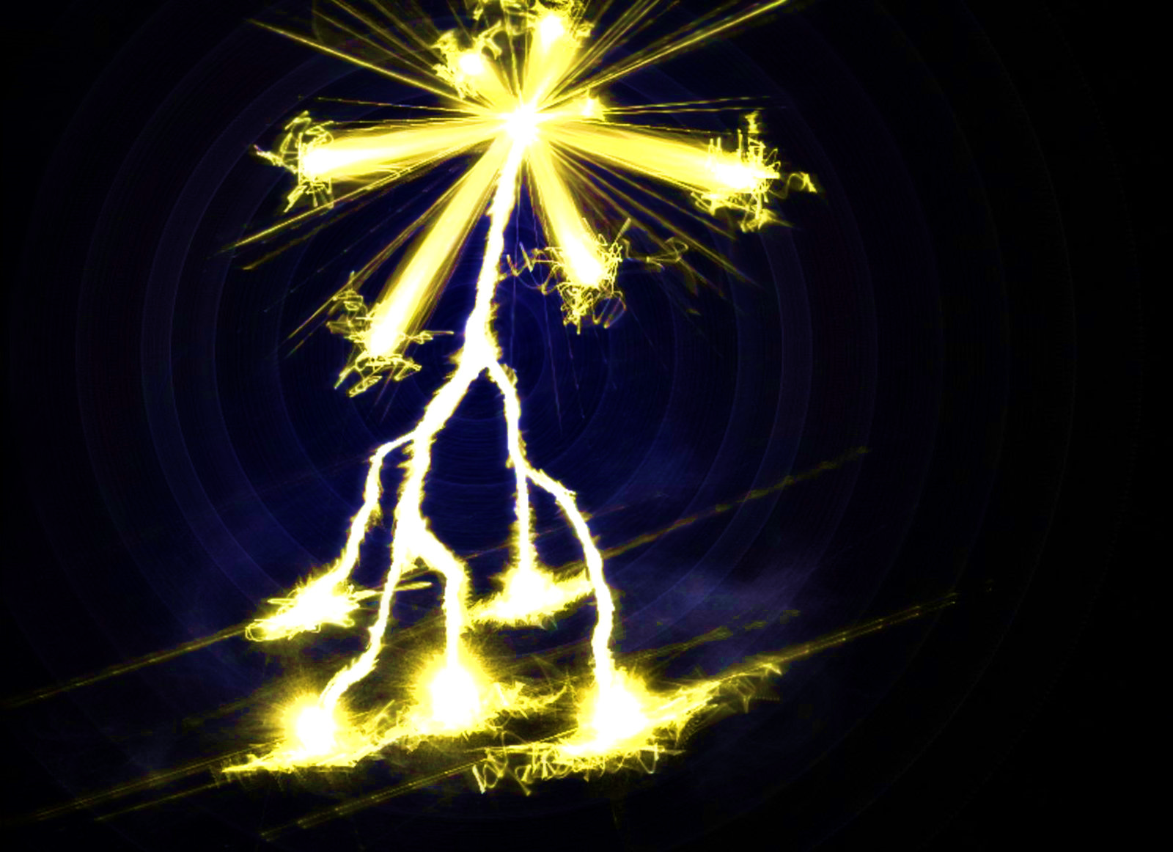
Title
Thunder and lighting on a humid summer day! Clouds are accompanied by strong wind and rain

Slide 3
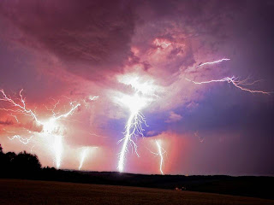
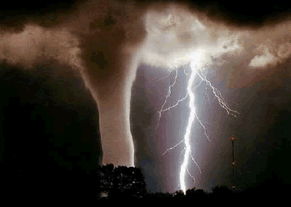
What is it
Inside a cloud
Cloud to ground
Cloud to cloud
Lighting
Lighting hits the trees

Slide 4
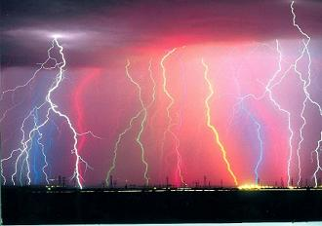
Damage
Thunder and lighting can do bad stuff like hitting trees and houses and school and other buildings and even people

Slide 5
Thunderstorm protection
Watch the weather
Listen to radio
Take shelter in a basement
Stay away from windows
Go by some thing and put your head down
To prevent them engineers are trying to give better warnings
This is bad

Slide 6
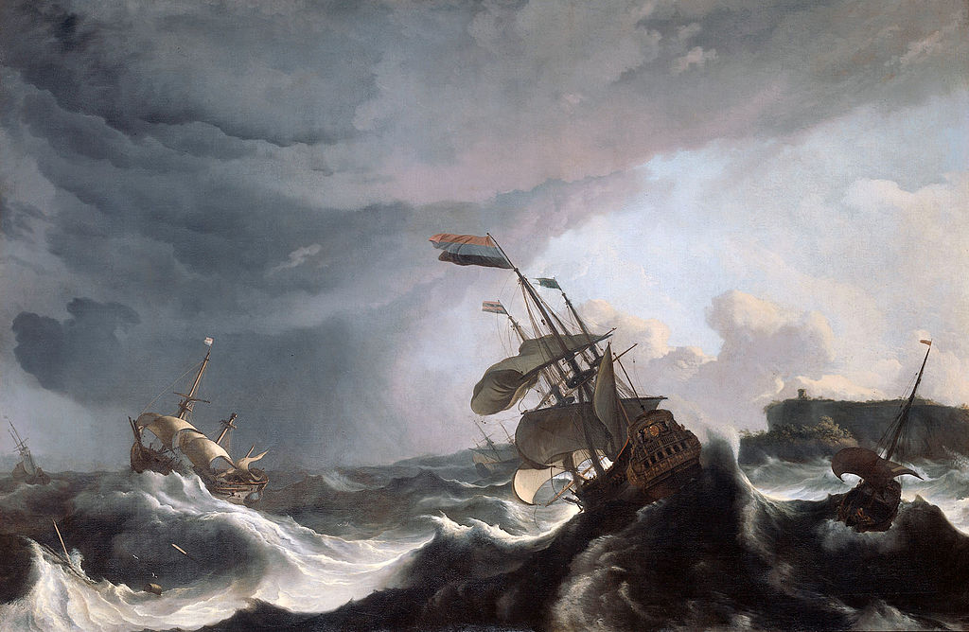
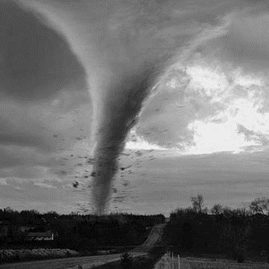
Thunderstorm in Iowa
Thunder is really bad because thunder can break schools and house and cars and church and the thunder can hurt people to the thunder can be bad because thunder can break stuff too
June 11, 2008
4 dead
48 injured
7.5 mile long path

Slide 7
The end😜😎😝😎😜

