Slide 1
tsunamis
By Alaina
Notes:
Rippling Water
(Basic)
Note: This video template is optimized for Microsoft PowerPoint 2010.
In PowerPoint 2007, video elements will play, but any content overlapping the video bars will be covered by the video when in slideshow mode.
In PowerPoint 2003, video will not play, but the poster frame of the videos will remain in place as static images.
The video:
Plays automatically after each slide transition.
Is 15 seconds long.
Seamlessly loops for infinite playback.
To add slides or change layout:
To add a new slide, on the Home tab, in the Slides group, click the arrow under New Slide, then click under Motion Background Theme, then select the desired layout.
To change the layout of an existing slide, on the Home tab, in the Slides group, click Layout, then select the desired layout.
Other animated elements:
Any animated element you insert will begin after the slide transition and the background video has started.
Layouts with video effects:
The “(Green) Title and Content” and “(Purple) Title and Content” layouts are creating by using a color overlay on the video.
With the video selected, under Video Tools, on the Format tab, in the Adjust group, select Color and choose Teal, Accent Color 6 Light (third row, seventh option from left) or Periwinkle, Accent Color 5 Light (third row, sixth option from left).

Slide 2
introduction
I have decided to do a tsunami when we had to choose a specific tsunami I choose the Japanese tsunami because I looked interesting

Slide 3
What is a tsunami
A tsunami is a big wave that covers the entire city. It is kind of like a hurricane but much more worse and dangerous. Lava and dirt hit the ground witch causes a tsunami.

Slide 4
Why does it happen?
First an earthquake starts under water then the tsunami surrounds the entire city and their was almost no way OUT!!!!!!!!!
OMG !!!!!!!!!!!!!!!!!!!

Slide 5
Picture of the Japanese tsunami

Slide 6
What is the impact on people?
People could have serious injuries and also DEATH!!!!!!!!! It damaged 3000 parts of that state where damaged. 15,891 people died that day
Are the people ok ?
NO!!!!!

Slide 7
What are engineers doing to help?
They are making buildings sway back and fourth instead of crumbling. They are also making triangular buildings so that they have a stronger bases and lower tops. They are also sending out telephone signals so they know when a tsunami is coming so that they can evacuate that city.

Slide 8
Closing
Fine leave me alone I’m DONE !!!!!!!!
That is why I choose tsunamis

Slide 9
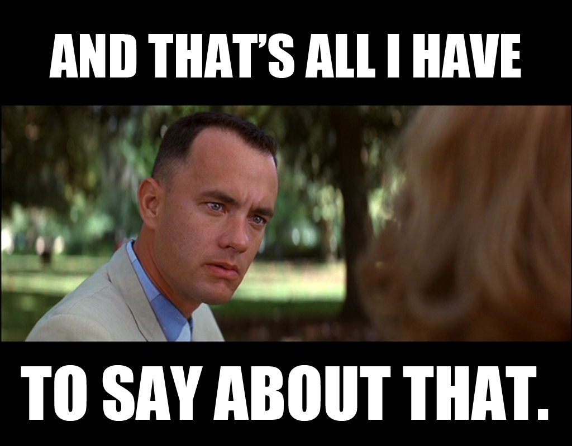
The end thanks for listening
For more information ask Alex nawn.Or get on the Wikipedia.

