Slide 1
Volcanoes
By: Kate

Slide 2
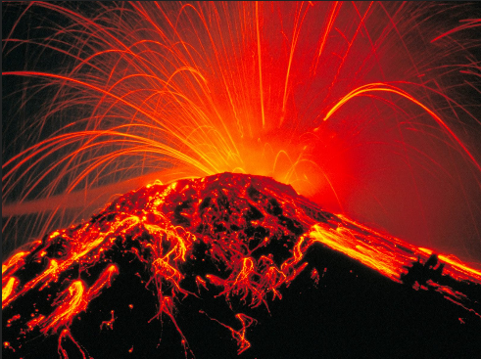
Introduction
I researched volcanos and hope that this will teach you some more facts about them.

Slide 3
The Impact on people
The worst impact on people is the ash and dust will fill the air which fills and covers everything for miles around the volcano. Volcanos may cause earthquakes or landslides. Sometimes they destroy crops or buildings.

Slide 4
Why they happen
Volcanos usually happen because the pressure builds up deep inside the earth. Then magma is pushed up to the surface. The volcano erupts and the magma reaches the surface called lava. A volcano is a rupture in the crust of the earth and when the crust brakes it will break into 17 major rigid tectonic plates that float on a hotter softer layer in its mantle.

Slide 5
What engineers are doing to help
Engineers are watching volcanos and measuring their activity. Then they try to figure out when it will next erupt, so that people can be warned to leave the area.

Slide 6
How you can help
Did you know that you can help prevent your house from falling down? As long as you can get the ash off of your house it may not collapse. But often the people leave because of the ash and are not around to continually clean off their roofs. If the ash fall is really heavy it can make it impossible to breathe.

Slide 7
The Thera Greece volcano
At its enormous height Thera erupted quickly and without warning. The towns appeared to have been destroyed. Since they now believe that it was one of the biggest volcanic eruptions of all time they are having archeological debates of how they could prevent these natural disasters.

Slide 8
Resources Trueflix pebble go Wikipedia

Slide 9
Thanks for watching!

