Slide 1
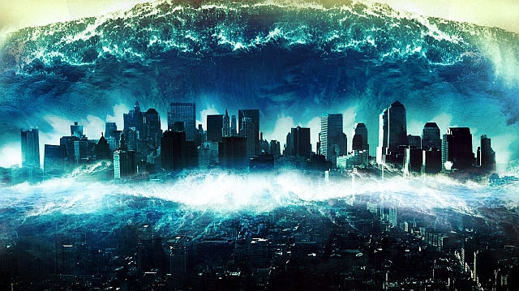
The Japanese tsunami
By winter
Notes:
Rippling Water
(Basic)
Note: This video template is optimized for Microsoft PowerPoint 2010.
In PowerPoint 2007, video elements will play, but any content overlapping the video bars will be covered by the video when in slideshow mode.
In PowerPoint 2003, video will not play, but the poster frame of the videos will remain in place as static images.
The video:
Plays automatically after each slide transition.
Is 15 seconds long.
Seamlessly loops for infinite playback.
To add slides or change layout:
To add a new slide, on the Home tab, in the Slides group, click the arrow under New Slide, then click under Motion Background Theme, then select the desired layout.
To change the layout of an existing slide, on the Home tab, in the Slides group, click Layout, then select the desired layout.
Other animated elements:
Any animated element you insert will begin after the slide transition and the background video has started.
Layouts with video effects:
The “(Green) Title and Content” and “(Purple) Title and Content” layouts are creating by using a color overlay on the video.
With the video selected, under Video Tools, on the Format tab, in the Adjust group, select Color and choose Teal, Accent Color 6 Light (third row, seventh option from left) or Periwinkle, Accent Color 5 Light (third row, sixth option from left).

Slide 2
Here is an example of an tsunami

Slide 3
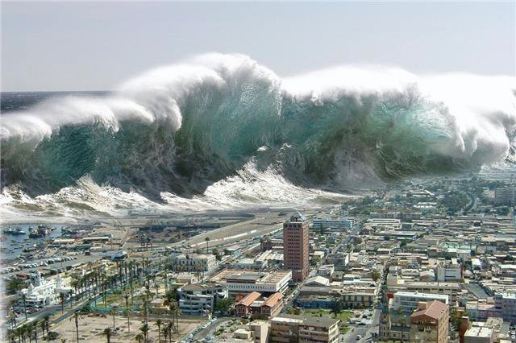
introduction
I chose tsunami. I decided to do the Japanese tsunami because it looked interesting to what happen to the people and the city.

Slide 4
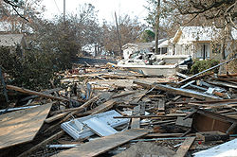
What is the impact on the people?
Death a destruction. 15,891 people died 2,500 people are still reported missing.

Slide 5
why does it happen
Underwater earthquakes makes the water to rise up and go to shore. What is a tsunami ? A tsunami is a huge set of ocean waves. An earthquake under the sea causes a huge wave called a tsunami. A tsunami can be 197ft high.

Slide 6
What is the impact on the area/ what are engineer doing to help?
The impact on the area is damage all the knocked down the whole city was ruin. Engineers are helping by re-building the city and trying to evacuate the city and finding people underneath the buildings.

Slide 7
My website was pebble go it had lots of information.

